Slide 1
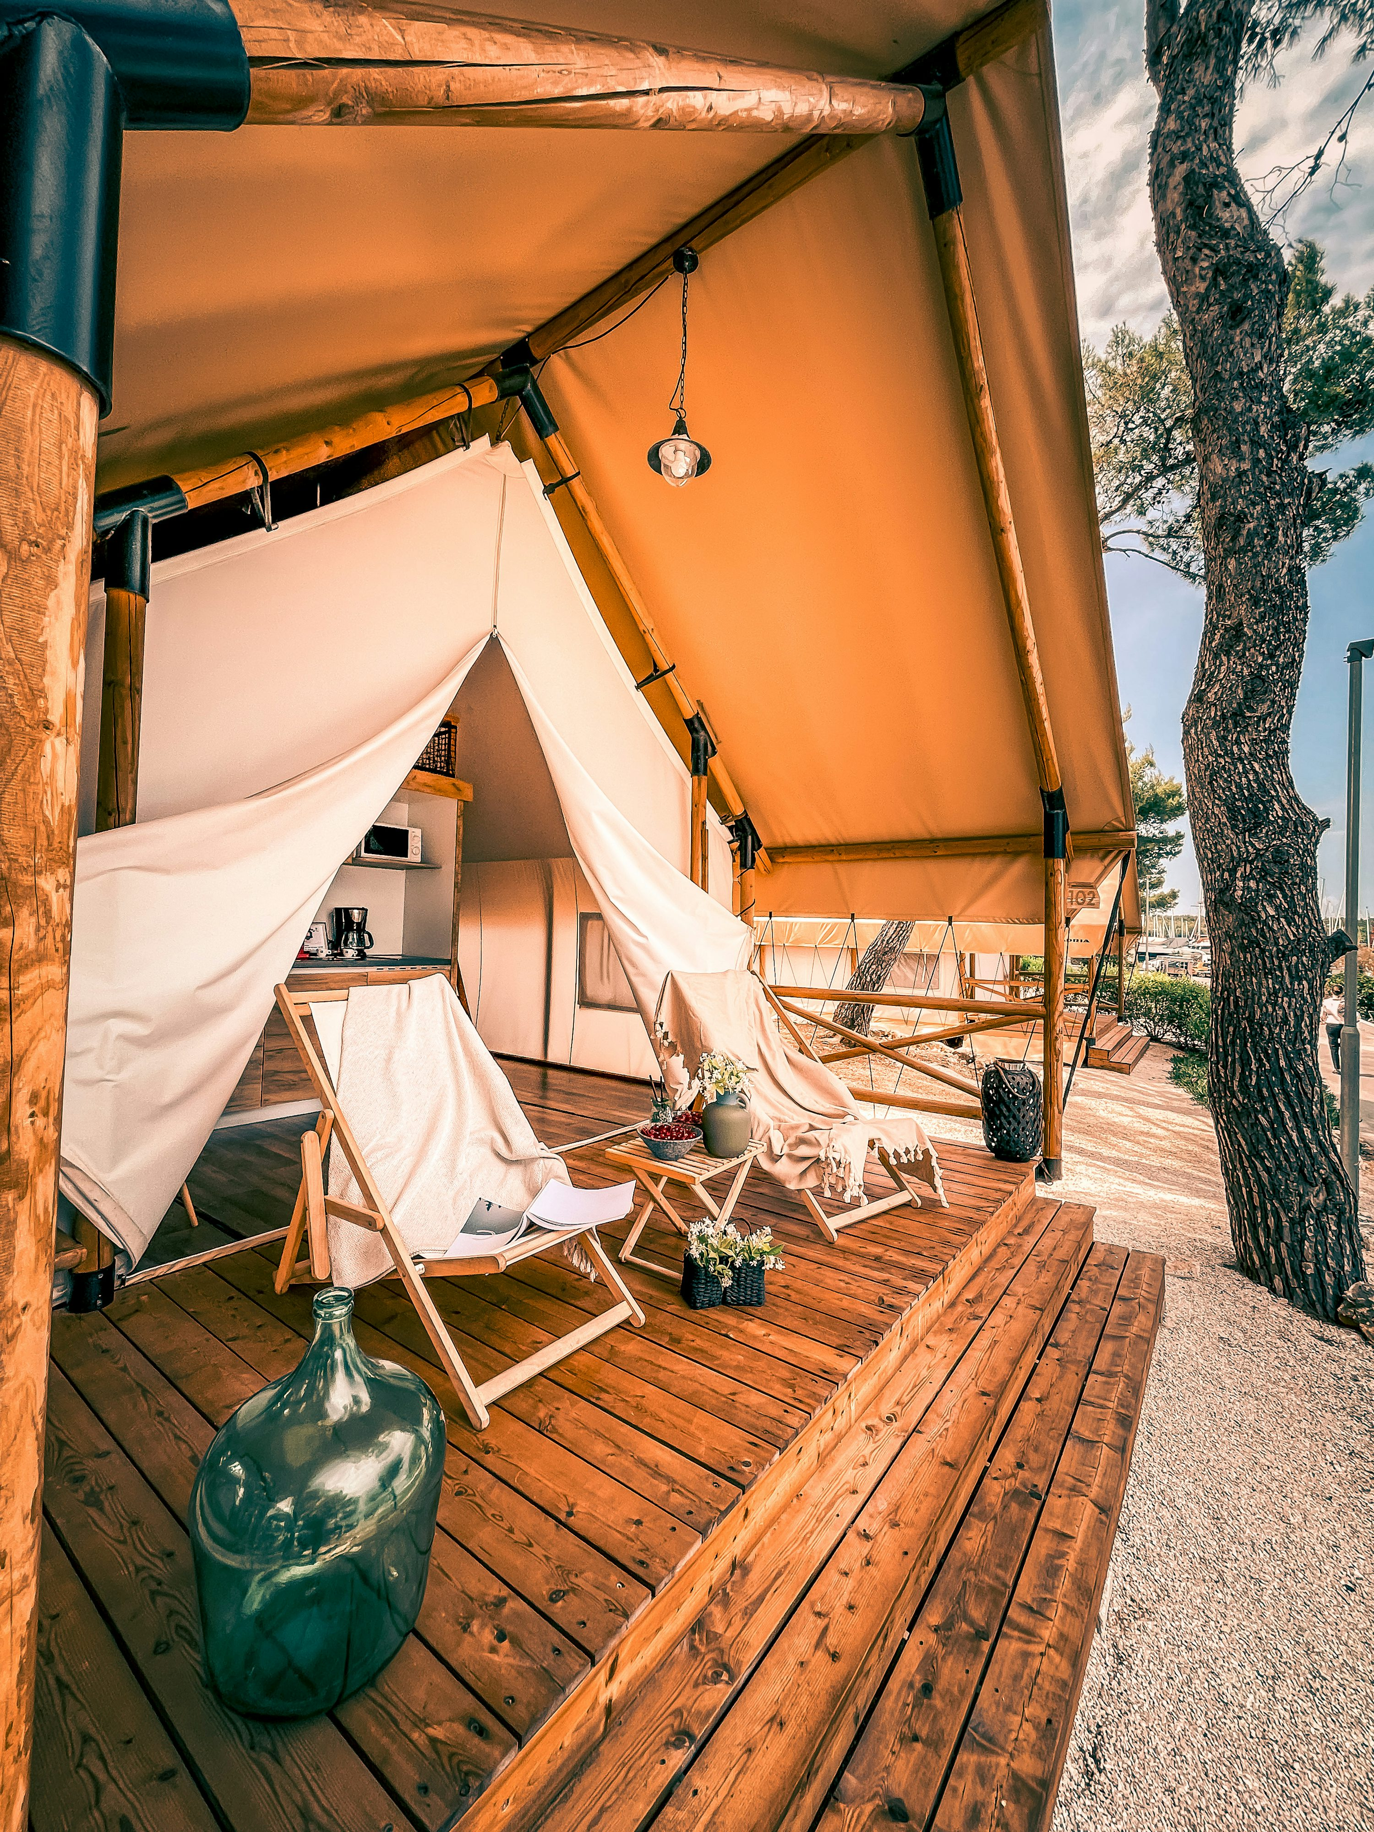


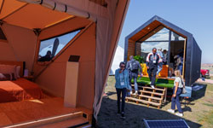
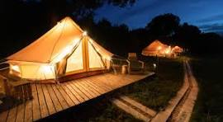
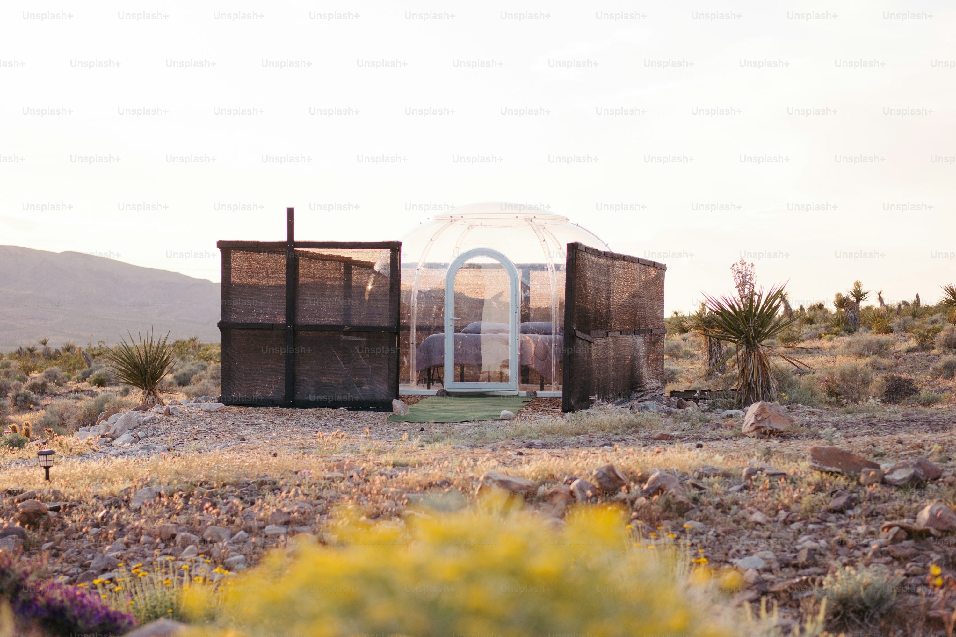
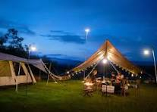
Glamping Show Americas
2024 Glamping Report
October, 2024

Slide 2
Background & Methodology
Objectives:
  Identify the current state of glamping among glamping operators and prospects.
  Evaluate the level of potential growth and expansion across operators and suppliers.
Method of data collection & timing
  All surveys were completed online using the Glamping Americas contact list with n=473 (MoE +/-4.4%) surveys completed in July of 2024.
Results are representative of the subset of respondents, and are intended to provide a snapshot of their views.
“The biggest change I’ve seen in how camping has changed in the past 10 years is glamping. I am a hardcore tent camper, but I went glamping this year for the first time, and now I will include a glamping trip every year.”
– Sharon W.

Slide 3
Introduction
2023 saw a minor decline in overall participation in camping, yet glamping continues to grow.
Leisure travelers are taking road trips and more day trips and are focused on convenience.
As properties expand accommodations offerings as well as amenities, the typical resort guest will continue to seek out glamping as a form of travel.
Glamping continues to grow, and is now well established in the mindset of the leisure traveler, and a luxury option for campers and families.

Slide 4
Current Operators

Slide 5
Years of Operation & Ownership Structure
How many years have you been in operation, or have you been providing glamping accommodations and services?
What type of ownership structure do you have?
How many locations do you have for glamping?

Slide 6
What type of property or properties do you currently own or operate?
Stand-Alone vs. Add-On
On vs. Off Grid

Slide 7
Are any of your properties near major destinations, and if so, which ones?

Slide 8
What was your initial cost to launch your business?
2023
Type of Funding Used
2024
Investment Needed for Future Growth: $909,148

Slide 9
Overall, what has been your estimated annual gross revenue? And what are your annual operational costs?
2023
When taking into consideration the reported operating costs, and nearly identical to last year, the typical glamping operator reports about $165,000 in net annual revenue.
2024

Slide 10
Looking back at when you first started, how did the permitting process take from the time you initiated it to completion?

Slide 11
What is your current level of staffing? //
And in the coming year, are you planning to …?
Current Number of Staff
Plans for Next Year’s Staff

Slide 12
What is the average daily rate (ADR) for each of the following?
Average by Unit Type
Across all operators, the ADR stands at $227 per night, a marginal $18 or 8% increase from 2023. 59% of the operators say that they will increase rates in the next year.
Average Number of Structures
Average by Region
Extra Charge for Pets?

Slide 13
Looking ahead, how many of each of the following do you plan to add?
Growth in Additional Locations
Average Number of Structures
Growth in Additional Structures

Slide 14
What types of infrastructure development and enhancement are or were needed, if any, at your property or properties?//
What are your primary barriers to infrastructure development and enhancement?
Infrastructure Needed
Barriers to Infrastructure Development

Slide 15
Which of the following services and amenities do you currently offer, plan to offer (or expand), and which are needed (but don’t currently have plans for)?

Slide 16
What is the average length of stay at your location(s)? // What is the current mix of guests you attract at your location(s)?
Guest Group Types
Average Length of Stay: 2.2 days

Slide 17
Thinking about the past 3 years (if you have been in operation for less than years, base your estimates on the past 1 or 2 years), what has been the estimated rate of growth for . . . ?

Slide 18
All things considered, what for you are the primary barriers to future growth? // What resources, if any, could you use to help you grow and expand?
Barriers to Growth
Resources Needed

Slide 19
What is the current configuration of bathrooms at your property or properties? // How much extra, if any, do you charge for private in-suite bathrooms?
Location of Bathroom
Extra Charge for In-suite Bathrooms

Slide 20
Which of the following marketing channels, if any, are you using? Which do you plan to use in the coming months?

Slide 21
What current method do you use for booking and reservations? // Do you currently, or do you plan to list any of your accommodations on any of the peer-to-peer listings below?
Booking Type Offered
Peer-To-Peer Listings

Slide 22
Prospective Operators

Slide 23
What type of property or properties are you considering?
Stand-Alone vs. Add-On
On vs. Off Grid
70% of prospective owners are planning to operate their businesses all year, compared to 56% of current operators.

Slide 24
At what stage are you in the planning process for your glamping operation?

Slide 25
How many, if any, of each of the following structures are you planning to include?
Average Number of Structures
Median Number of Planned Structures: 27

Slide 26
What type of ownership/ownership structure will you have?

Slide 27
Are any of your planned or existing properties near major destinations and if so, which ones?

Slide 28
How many locations are planning to have for glamping? //Looking ahead, how many of each of the following do you plan to add?
Planned Number of Locations
Planned Rate of Growth

Slide 29
All things considered, what for you are the primary barriers to future growth? // What resources, if any, could you use to help you grow and expand?
Barriers to Growth
Resources Needed

Slide 30
Which of the following services and amenities do you plan to offer?

Slide 31
What will be the configuration of bathrooms at your property or properties? // How much extra, if any, will you charge for private in-suite bathrooms?
Location of Bathroom
Extra Charge for In-suite Bathrooms

Slide 32
What type of financing will you use to fund your business?

Slide 33
Which of the following marketing channels, if any, are you planning to use?

Slide 34
What method do you plan to use for booking and reservations? // Do you plan to list any of your accommodations on any of the peer-to-peer listings below?
Planned Booking Type
Planned Peer-To-Peer Listings

Slide 35
Those Who Decided Not to Get Started In The Glamping Industry

Slide 36
What are the primary reasons why you decided not to get into glamping, or that you have put your plans on hold?

Slide 37
Contact Information
Our organization has stayed on the forefront of the market research industry by offering our clients a full suite of research services, as well as the analytics and insights to move their organizations forward.
In particular, our work on the North American Camping Report has been nationally recognized, being cited in such notable media outlets as The New York Times, Chicago Tribune, LA Times, NBC News, Fox Business News, USA Today and CBS News. This work has been recognized by PR Week in the “Best in Analytics” category for both 2017 and 2018 and a Sabre Award for “Best Post Campaign Analysis” in 2018 and 2019.
207.409.0929
sbahr@cairnconsultinggroup.com
www.cairnconsultinggroup.com

