Slide 1
Investment Strategies for Glamping Entrepreneurs
From Concept to Capital

Slide 2
Overview
Strength of team
Know who you are and build the right team around you.
Strong Financials and Rollout Plan
You don’t have to be an accountant, but it helps tremendously to understand the basics
1
3
2
Market Fit and Site Potential
Site location and amenities that will draw visitors and keep them on site
4
The Pitch
The deck, The Outreach, The Talk

Slide 3
Strength of Team

Slide 4
Team
Complete Skill Set - Design, Marketing, Finance, Operations, Accounting, Repair
Experience - Hospitality, Food and Beverage
Redundancy - What if
Investor Role - passive or active
Skin in the Game - who has it?
Notes:
Investors may want to place their own people

Slide 5
Market Fit and Site Potential
Notes:
Vision

Slide 6
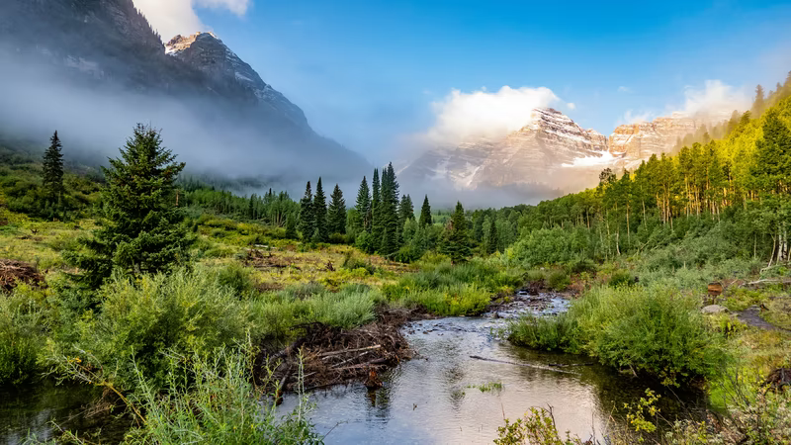
Market & Site
Market viability
Site Suitability
Comps
Annual Visitors
Distance from Metro Areas
Utilities/Infrastructure
Water and Fire Risk
Seasonality

Slide 7
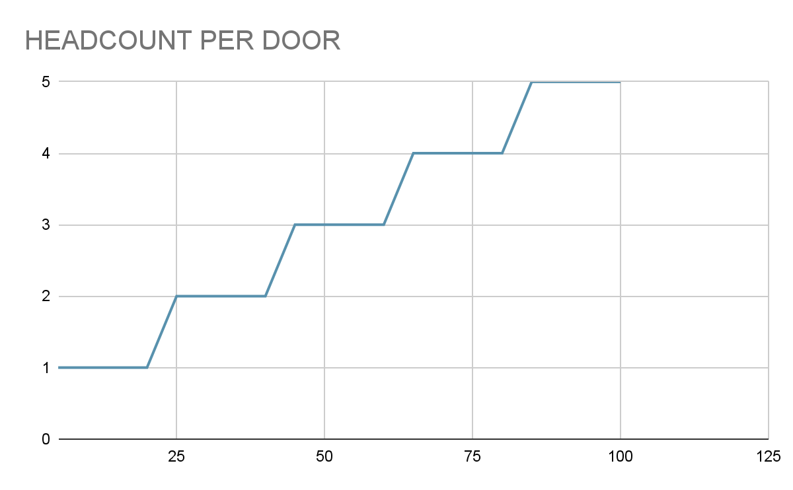
Right Sizing
The pie needs to be split
Headcount is a step function
Upside for all
Too big or too small increases risk
Right size staff to control costs
Outsource where appropriate
Build in Redundancy & Turnover
Location Impact on Staffing

Slide 8
Strong Financials and Rollout Plan

Slide 9
Timeline
Pre-Development
Stabilization
Exit
Development
Growth
Design, Engineering, Permitting
Base Staffing, revenue, profit
Investors will want their money back, with a nice return
20XX
20XX
20XX
20XX
20XX
Utilities, Unit Mix, Room to grow
Funded with profits or future investment rounds?

Slide 10
Projected Pro Forma
Summary
Buildout $$
Buildout Result
Cashflow
$$ Exit
Total Cost
Cost of Acq
Capital Proj A
Capital Proj B
Capital Proj C
…
Capital Proj Z
Soft Costs
Assumptions
OCC/ADR
Events
Food & Bev
Store
Monthly
Revenue
COGs
OPEX
NOI
Debt Svc/Other
CashFlow
>> by month >>
>> by year >>
Debt
Principal
Rate
Monthly Pmt
Balance Due at time of sale

Slide 11
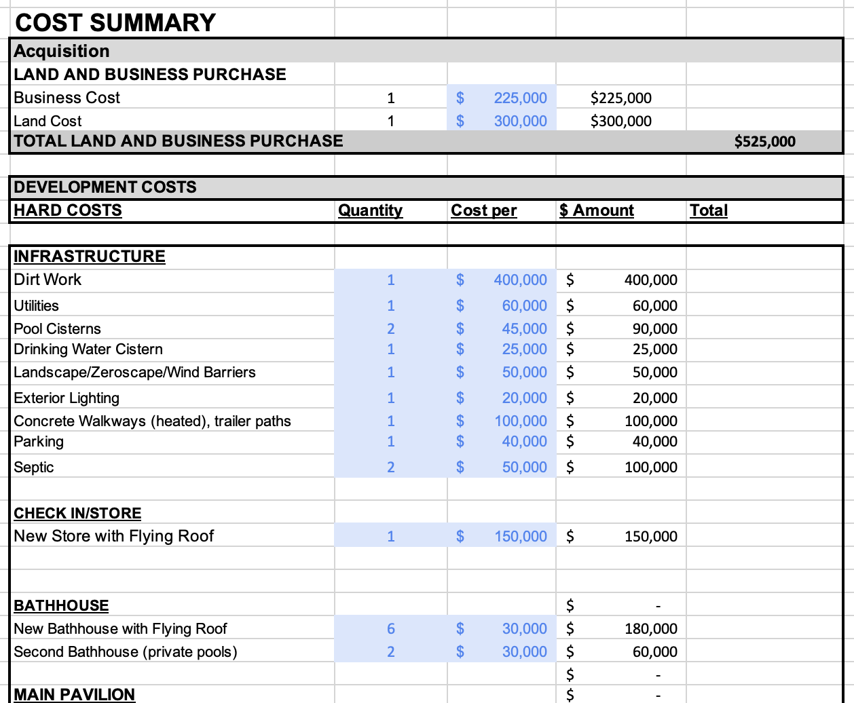
Total Project Cost
Land Acquisition
Business Acquisition
Hard Costs
Infrastructure, Buildings, Repairs
Soft Costs
Engineering, Consultants, Legal

Slide 12
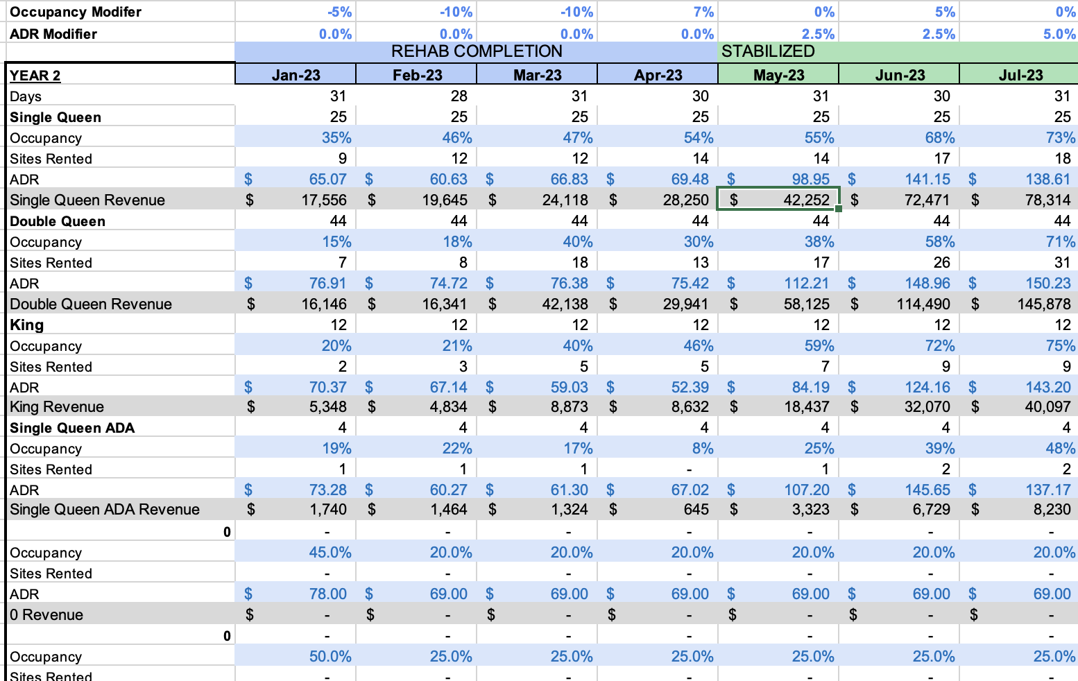
Revenue Assumptions
OCC/ADR assumptions
By unit type
Seasonally Adjusted
Events, Store, Other
Occupancy Driven

Slide 13
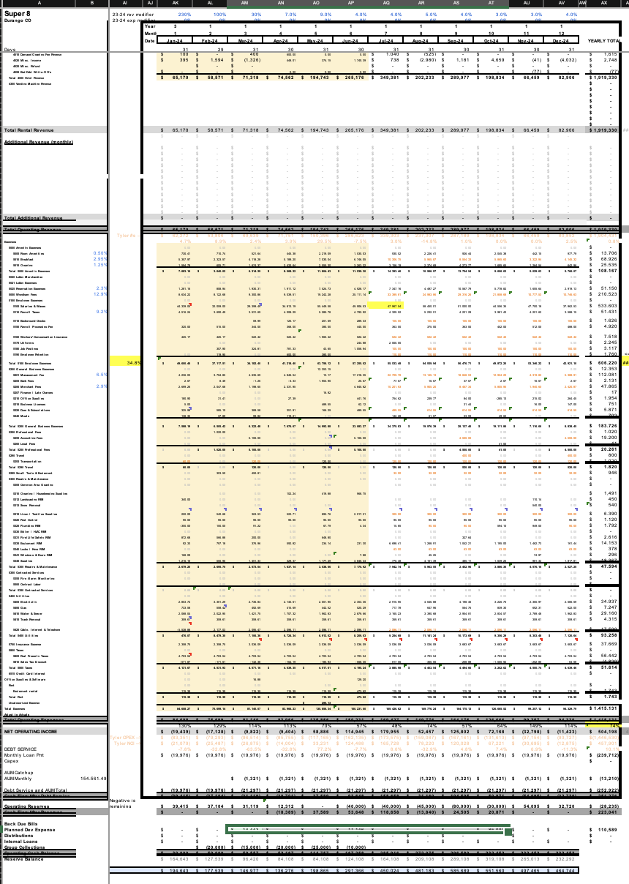
Monthly Projections
Conception through stabilization
Big “buckets” ok to start
Be Realistic
Add CONTINGENCY
Use this to run your Business and to communicate with investors!
Notes:
Use Calendar Year!

Slide 14
Monthly Projections & Variability
(Mostly) Fixed
Variable
Insurance
Property Tax
Dues and Subscriptions
Housekeeping
Amenities
COGs
CC & OTA Fees
Utilities
(% of Revenue or Number of Stays)

Slide 15
Sanity Checks
Investors will perform a deep dive, but a few sanity checks go a long way.
OPEX
ADR/OCC
Dev Cost
40-60% of revenue
market ADR, Occupancy, and seasonality
Get Quotes, understand local fees and timing
Debt
Expenses
Time
50-80% LTC, rates, term
Fixed versus Variable
To stabilization. To exit.

Slide 16
The Pitch

Slide 17
Use good templates Be Authentic Not every investor is a good fit

Slide 18
Thank you.
Shawn Bertini

Slide 19
TO ADD
Investment Strategies for Glamping Entrepreneurs: From Concept to Capital
This session is tailored to new and aspiring glamping operators eager to secure capital, funding, and investment for their ventures. In this session, our experienced speaker, a seasoned investor in the glamping industry, will share invaluable insights on how to position your property to attract investors. From understanding the needs and preferences of different investor types, whether institutional or personal, to crafting compelling investment pitches, attendees will gain a comprehensive understanding of what it takes to stand out in the eyes of potential investors.
Discover the key strategies, both big and small, that can make your glamping property an irresistible investment opportunity. Learn how to showcase your unique value proposition, leverage your property's strengths, and mitigate potential risks to instill confidence in investors. Whether you're seeking funding for infrastructure development, expansion plans, or operational improvements, this session will provide actionable tips and best practices to help you navigate the complex landscape of securing investment for your glamping operation. Don't miss this opportunity to gain the knowledge and expertise you need to propel your venture to new heights.
Updated Pro Forma
Pro Forma Walkthrough
Sales Intentions
Per diem rate capture
Investor Types/Sources
Using AI (??)
Buy existing – build new

