Slide 1
Understanding key metrics that drive profit and fuel growth
Room for improvement

Slide 2
Who am I?
Tyler Otto, MBA
President | Owner of Specialized Accounting
Host of UnAccountable! Podcast
Passions
- Hotel Finance Metrics and KPIs
- System & Process Implementation
- Referencing Song Lyrics and 80s Movies
- Making Lists (see above)
Notes:
But also a fun fact, I’m a Dweeb. I love Automating, I’m always up for a board game, KPIs, and I’m the type of guy that will watch a sporting event and have the state sheet open on my phone. I love Numbers. In fact, I love statistics so much, I want to devote my time today to giving credit to one of the greatest heroes of any professional sport ever…. The Scoreboard.

Slide 3
History of the scoreboard
Notes:
Baseball – Hand Scorecards
People would track the score of the game, and compare notes with others. If you arrived late or went to the bathroom you have missed a play. You’d have to rely on others to catch you up.
-
First Scoreboard in US in 1893 at Harvard football Thanksgiving Game
Baseball brings around the Electronic Scoreboard in the 1900s

Slide 4
History of the scoreboard
Notes:
Scoreboard changed the way the game was watched
Foul counts has a Significant impact on the strategy of the game
Scoreboard not only allowed all of us to view the game the same way, but also allowed for my favorite trash talk of all time. “ScoreBoard”
We need to not just show our clients the Final Score (Profit and Loss), but what things are happening in their biz that they can focus on to affect the final score.

Slide 5
Let's review some financials

Slide 6
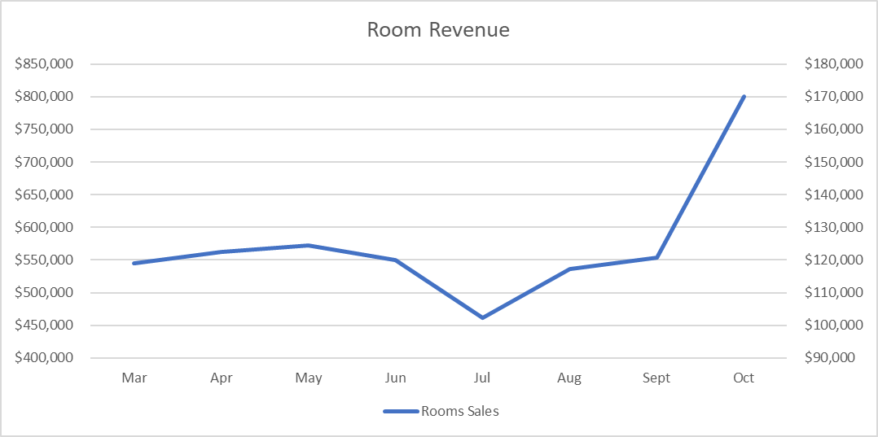
TRACKING REVENUE ONLY

Slide 7
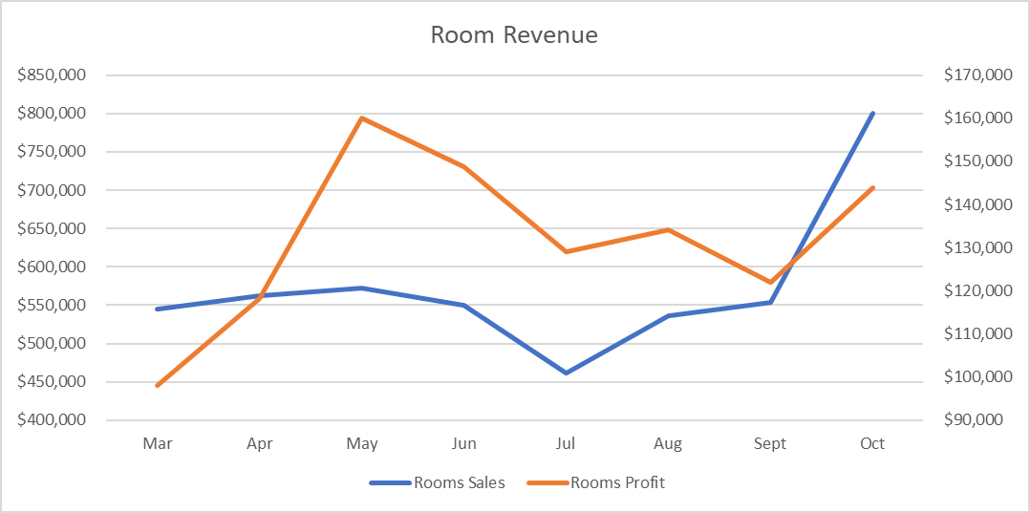
TRACKING REVENUE ONLY
Notes:
They will look at profit and think, July is going bad. Time for a new manager.

Slide 8
Profit Margin
How many pennies of every dollar of revenue make it to profit?
Formula: Profit / Revenue
Notes:
FOR THOSE OF YOU READY TO TUNE OUT NOW, STICK AROUND, WE ARE GOING TO JUMP INTO SOME MORE COMPLICATED STUFF, BUT LETS START WITH SOME SOFTBALLS

Slide 9
Revenue + Profit vs. Profit + profit margin
Only Part of the Picture
Examining Efficiency

Slide 10
Cost per occupied Room (CPOR)

Slide 11
Cost per occupied Room (CPOR)
Formula: Total Expenses in Rooms Department / Total Rooms Occupied

Slide 12
Cost per occupied Room (CPOR)
Formula: Total Expenses in Rooms Department / Total Rooms Occupied

Slide 13
Cost per occupied Room (CPOR)
Formula: Total Expenses in Rooms Department / Total Rooms Occupied

Slide 14
Two biggest Culprits of poor profit margin
Labor Margin
Cost of Goods Sold Margin

Slide 15
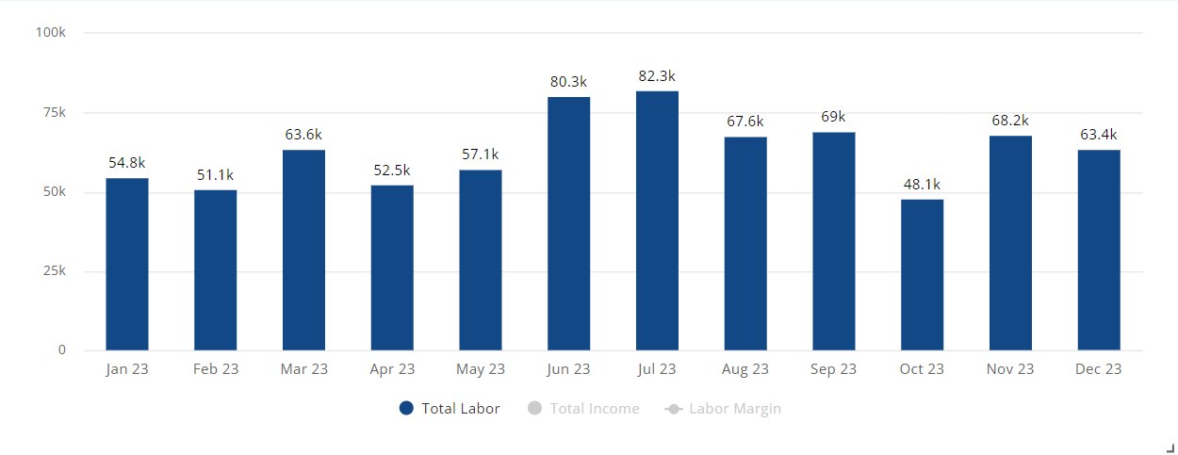
Labor margin
Rooms Department

Slide 16
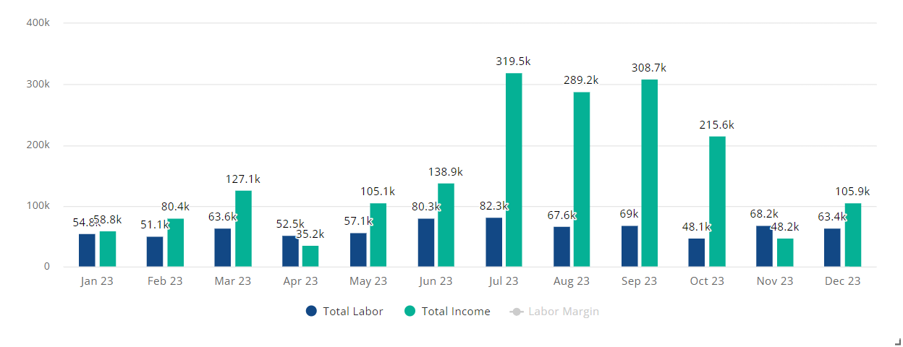
Labor margin
Formula: Labor Costs / Gross Sales
Rooms Department

Slide 17
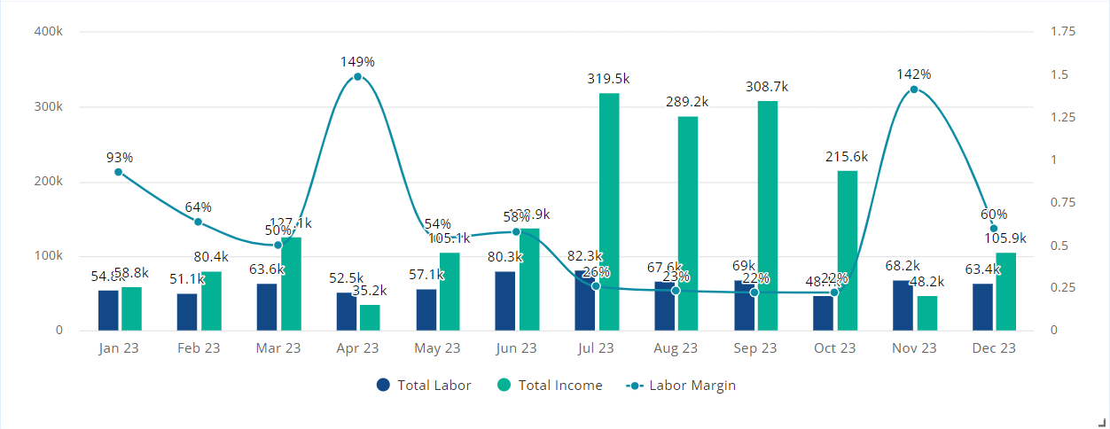
Labor margin
Formula: Labor Costs / Gross Sales
Rooms Department

Slide 18
Causes of Labor Margin Chaos
Overtime
Over/Under Staffing
Wage Theft

Slide 19
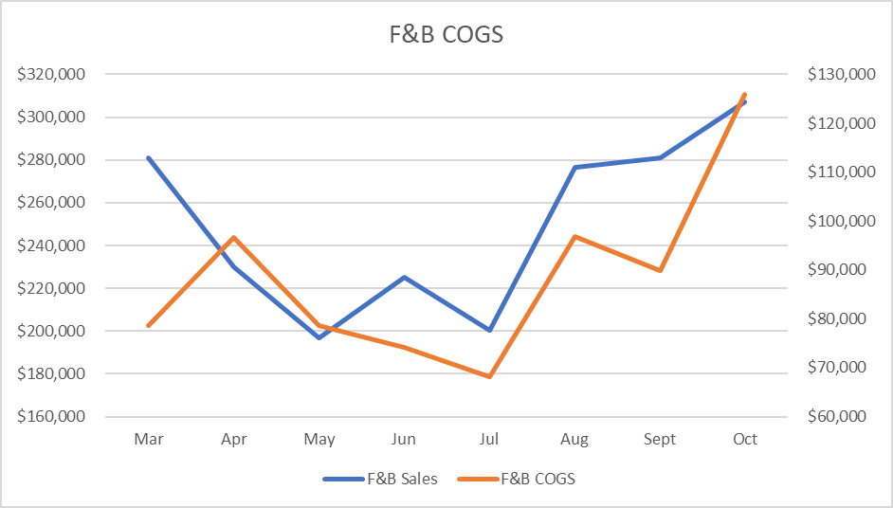
Cost of goods sold (cogs)
Formula: Beginning Inventory + Purchases – Ending Inventory = COGS

Slide 20
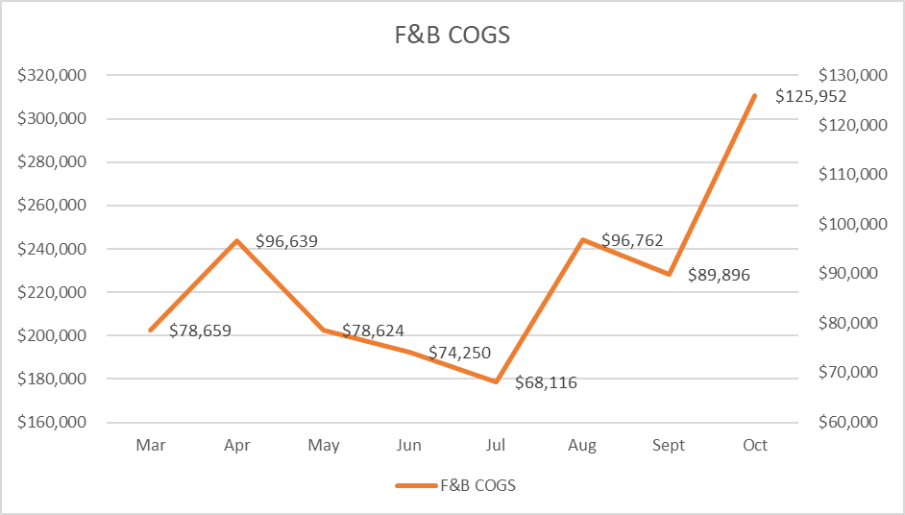
Cost of goods sold (cogs) margin

Slide 21
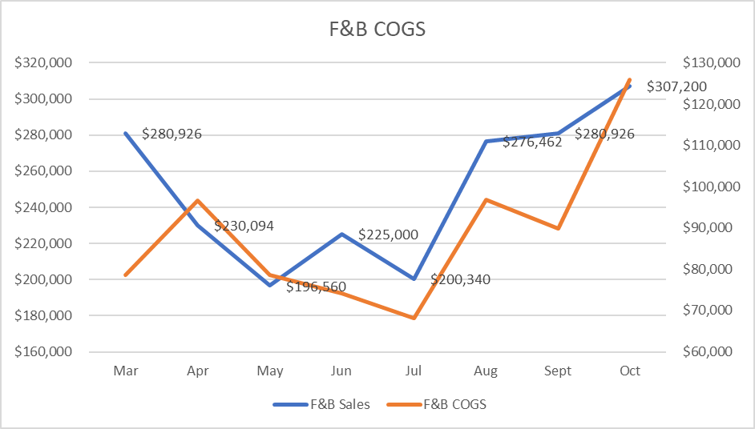
Cost of goods sold (cogs) margin

Slide 22
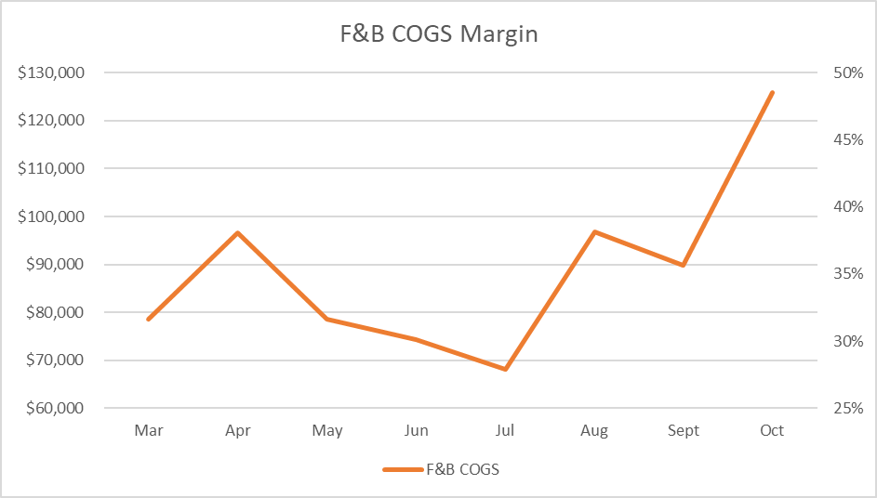
Cost of goods sold (cogs) margin
Formula: COGS / Total Revenue

Slide 23
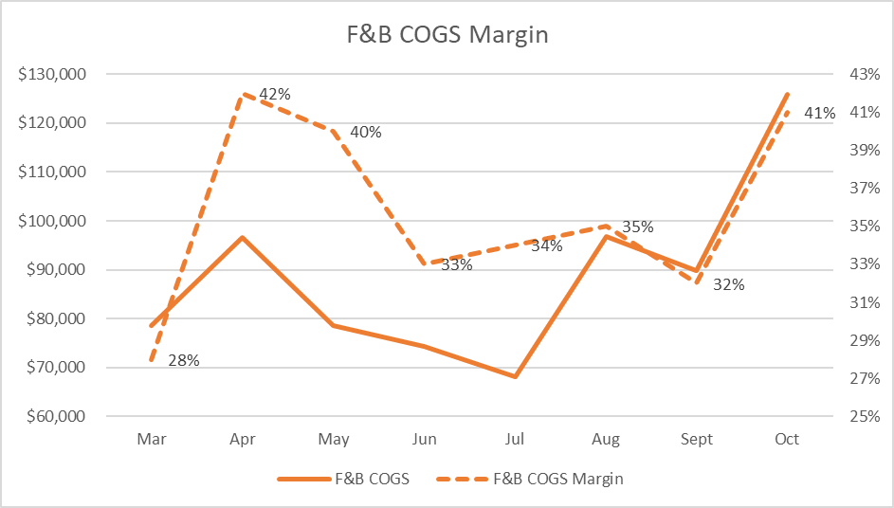
Cost of goods sold (cogs) margin
Formula: COGS / Total Revenue

Slide 24
Cost of goods sold (cogs) margin
Formula: COGS / Total Revenue

Slide 25
Causes of COGS Margin Chaos
Waste
Spoilage
Theft

Slide 26
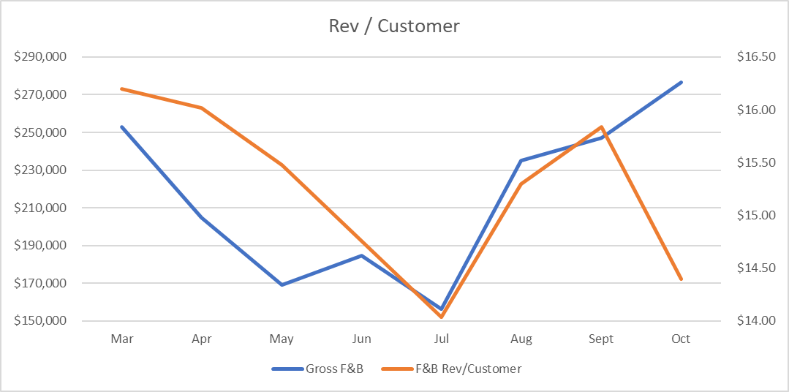
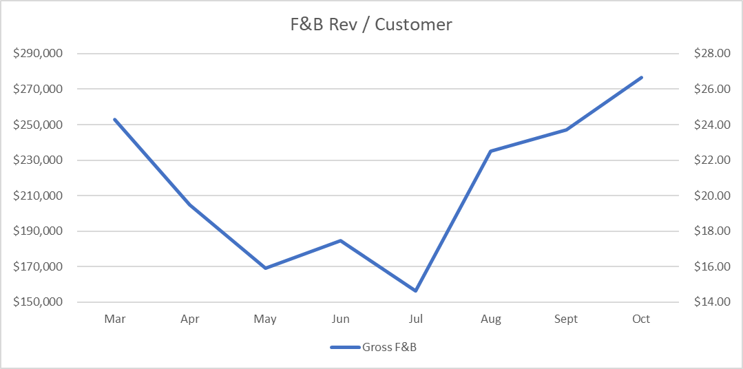
discount margin

Slide 27
discount margin

Slide 28
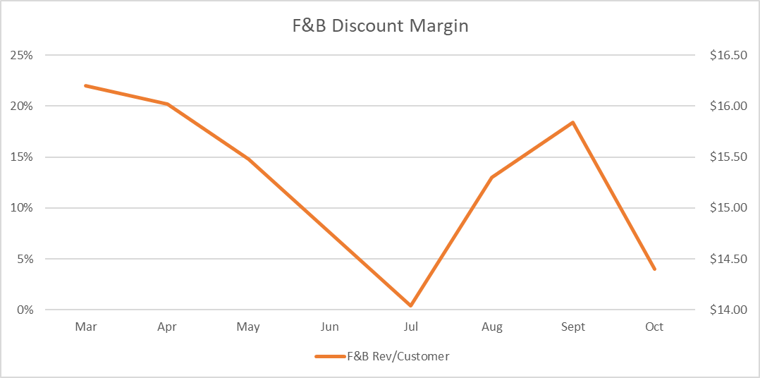
discount margin
Formula: Total Discount $ / Total Gross Sales

Slide 29
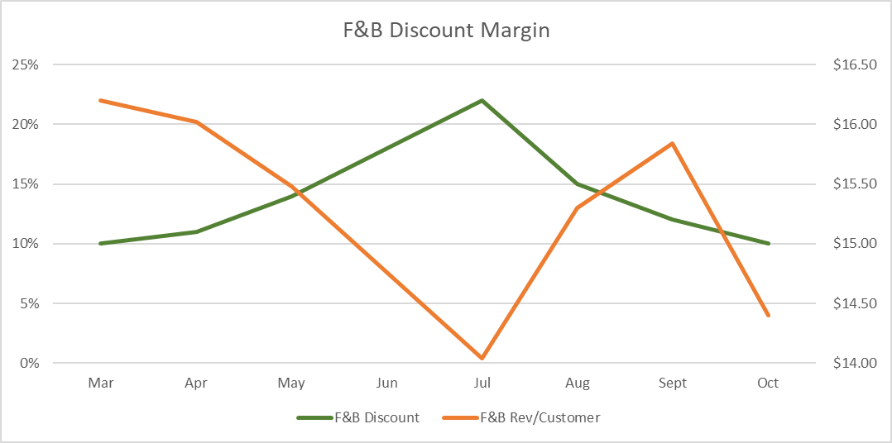
discount margin
Formula: Total Discount $ / Total Gross Sales

Slide 30
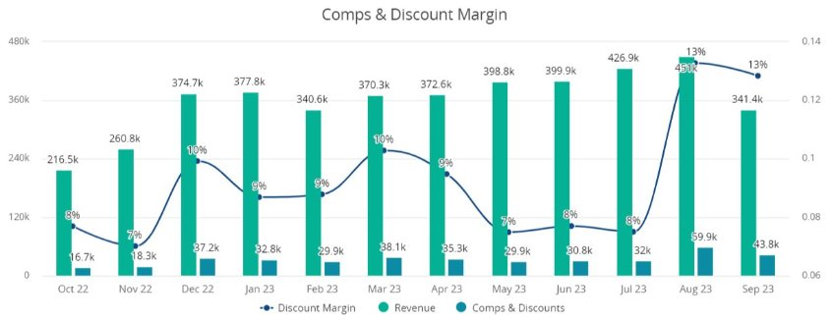
Comps & discount margin

Slide 31
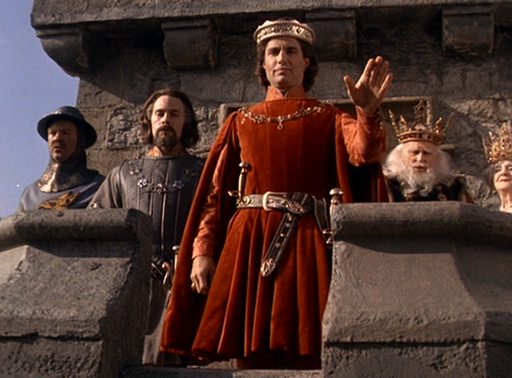
Cash Health
Revenue is Vanity
Profit is Sanity
But Cash is King!

Slide 32
Burn rate

Slide 33
Burn rate
Formula: Cash in the Bank / Average Monthly Expenses

Slide 34
Burn rate
Formula: Cash in the Bank / Average Monthly Expenses

Slide 35
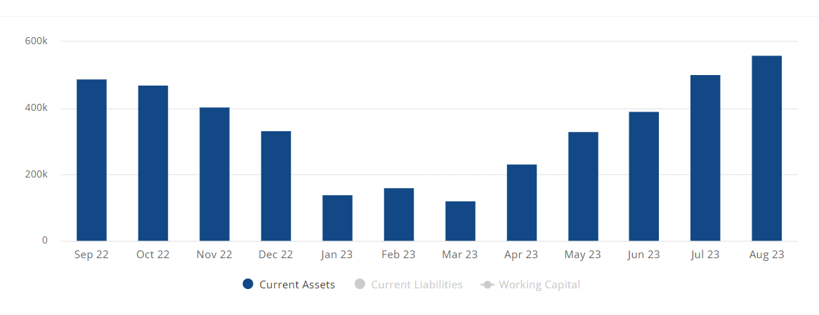
Working capital

Slide 36
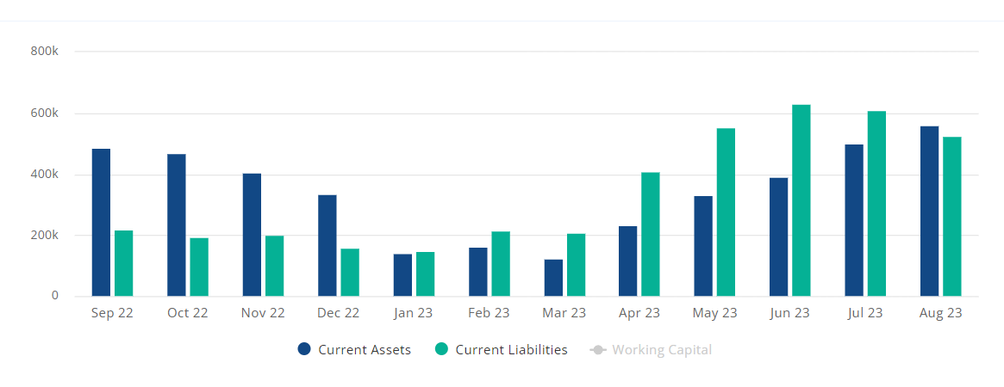
Working capital
Formula: Total Current Assets – Total Current Liabilities

Slide 37
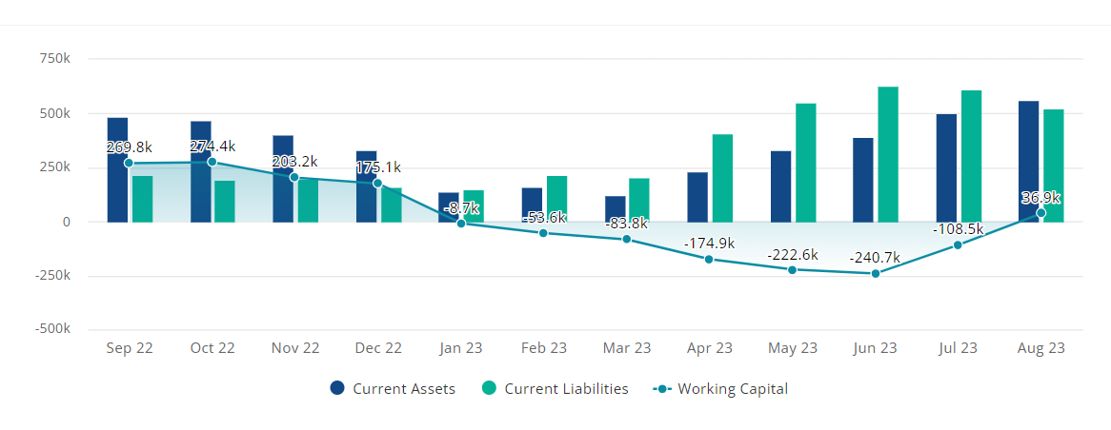
Working capital
Formula: Total Current Assets – Total Current Liabilities

Slide 38
Your cash
Formula: Total Bank Balances – Advanced Deposits

Slide 39
Nonfinancial metrics

Slide 40
Standard Revenue Management Metrics
Occupancy
Average Daily Rate
Pacing

Slide 41
Occupancy rate
Formula: Rooms Sold / Total Rooms

Slide 42
Average daily rate (ADR)
Formula: Room Revenue / Rooms Sold

Slide 43
But Tyler, my E.R.P. doesn’t have statistics

Slide 44
Best Practices
You can’t have clean KPIs without clean books.
The finance people can find it, but ops needs to fix it.
Keep it simple.

Slide 45
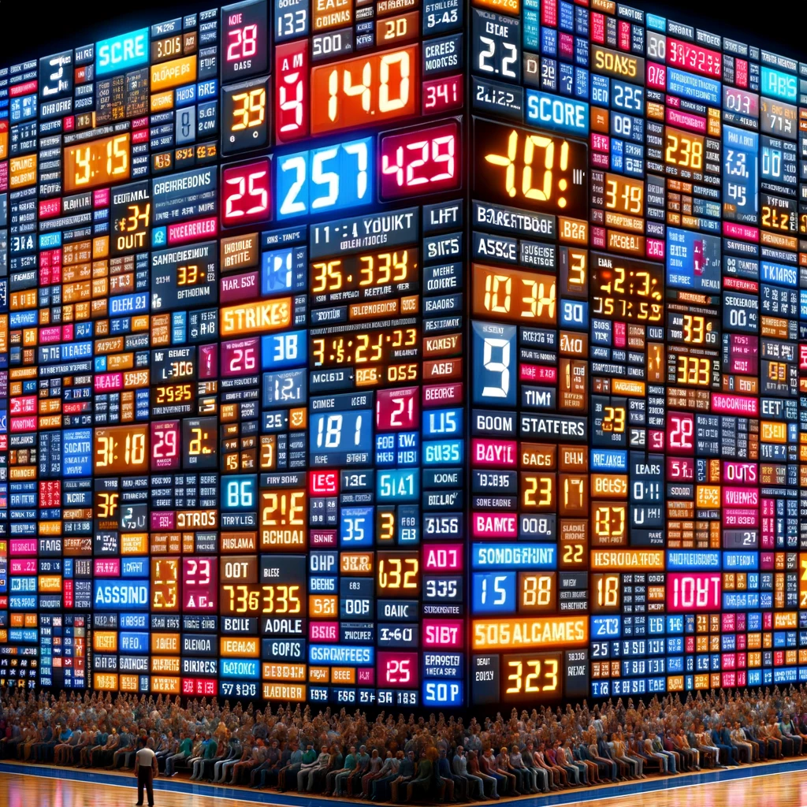
Keep It Simple
Too much data is overwhelming.
Keep the numbers simple & easily digestible.
Notes:
An example of “keep it simple”

Slide 46
Free Key metrics pdf
Notes:
Scoreboard Reference!

Slide 47
Thank you
Tyler@SpecializedAT.com
www.specializedat.com
Notes:
Unaccoutnable Earn CPE for listening
Throw it back to Sarah

